Slide 1
Lecture 3 Use Case Diagram
Chapter 17 & 18
The Unified Modeling Language User Guide
SECOND EDITION
By Grady Booch, James Rumbaugh, Ivar Jacobson
Session 5 & 6
UML Weekend Crash Course
Thomas A. Pender

Slide 2
Objective
Capture the intended behavior of the system
Without specifying how that behavior is implemented.
Use cases provide a way for developers to come to a common understanding with your system's end users and domain experts.
In addition, use cases serve to help validate your architecture and to verify your system as it evolves during development.
Use cases specify WHAT are the externally visible behaviors; they DO NOT dictate HOW that behavior will be carried out internally.

Slide 3
What is Use Case?
A use case is a description of a set of sequences of actions, including variants, that a subject performs to yield an observable result of value to an actor.
For example, one central use case of a bank is to process loans for its loan applicants/ clients/ customers.

Slide 4
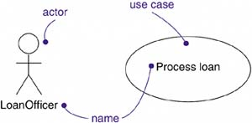
What is Actor?
An actor represents a coherent set of roles that users of use cases play when interacting with these use cases.
Actors can be a human role, or they can be automated systems.
For example, in modeling a bank, processing a loan involves, among other things, the interaction between a customer and a loan officer.

Slide 5
Actors
Find the people, systems, or devices that communicate with the system.
The system-type actors are often easiest to spot as interfaces and external communication, such as notifications to the Accounts Payable and Order Processing systems.
The other actors will be participants in the operation of the Inventory Control system.
All these users will become sources for finding and validating the required features of the system (that is, Use Cases).

Slide 6
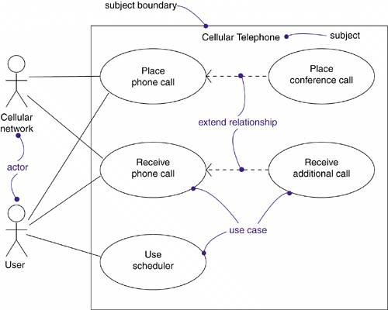
Use Case Diagram
Apply use case diagrams to visualize the behavior of a system, so that users can comprehend how to use that element, and so that developers can implement that element

Slide 7
Modeling the Requirements of a System
Establish the context of the system by identifying the actors that surround it.
For each actor, consider the behavior that each expects or requires the system to provide.
Name these common behaviors as use cases.
Factor common behavior into new use cases that are used by others; factor variant behavior into new use cases that extend more main line flows.
Model these use cases, actors, and their relationships in a use case diagram.
Enhance these use cases with notes or constraints that assert nonfunctional requirements; you may have to attach some of these to the whole system.

Slide 8
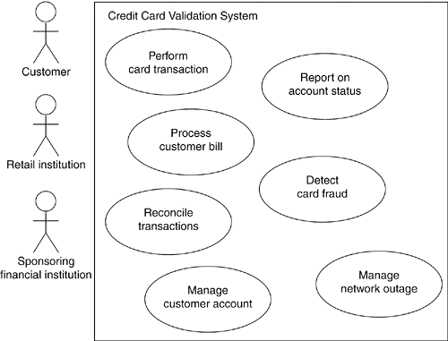
Modeling the Requirements of a System

Slide 9
Elements of Use Case Diagram

Slide 10
Relationships in Use Case Diagram
Association
Between Actor and its Use Cases
NOT between Use Cases
NOT between Actors
Generalization
Between Actors
Between Use Cases
Dependency
Between Use Cases ONLY
<<include>> and <<extend>>

Slide 11
Dependency
<<include>>
Mandatory dependency
<< i >>
Arrow towards the use case dependent on
<<extend>>
Optional Dependency
<< e >>
Arrow from the use case dependent on
Often referred as options of the use case

Slide 12
Generalization

